Slide 1







ANALYSIS OF COVID-19 AND BREAST CANCER
By: Hamza, Mina, Dean, Shan, Fozia, Alejandra

Slide 2


Introduction
Breast Cancer
2nd leading cause of cancer death among women in the US
19.6 breast cancer deaths per 100,000 [1]
[1] Giaquinto AN, Sung H, Miller KD, et al. Breast cancer statistics, 2022. CA Cancer J Clin. 2022;72(6):524-541. doi:10.3322/caac.21754

Slide 3
Introduction
COVID-19 and Cancer
13% to 33% mortality rate for patients with cancer and COVID-19 [1] compared with 0.5% to 2% in the general population
Increased risk of SARS-CoV-2 infection and adverse outcomes [1]
[1] Giaquinto AN, Sung H, Miller KD, et al. (2021). Association of clinical factors and recent anticancer therapy with COVID-19 severity among patients with cancer: a report from the COVID-19 and Cancer Consortium. Annals of oncology : official journal of the European Society for Medical Oncology, 32(6), 787–800. https://doi.org/10.1016/j.annonc.2021.02.024. CA Cancer J Clin. 2022;72(6):524-541. doi:10.3322/caac.21754

Slide 4

Mortality Rates*
Breast
Cancer**
COVID
(cancer in remission)
3.191%
32.467%
20.35%
30 of 31 survive
2 of 3 survive
4 of 5 survive
* based on CCC19 DOI: https://doi.org/10.7554/eLife.82618
**given at-least a diagnosis of mild COVID

Slide 5



Objective
Shed light on the sociodemographic and clinical factors that influence these adverse outcomes in both COVID-19 and Breast Cancer
Notes:
Hence the the focus for us today is:
to shed light on the sociodemographic and clinical factors that influence these adverse outcomes
With the hope of:
- elucidating risk factors and joint clinical manifestations, and informing Screening Guidelines for both BC and COVID.
- Uncover differences in outcomes for different demographic groups including disparate outcomes
- assessing treatment efficacies
- and ultimately help guide patient care.

Slide 6
Outline
01
01
02
The isolated effect of AGE on the risk of severe COVID-19 and Breast Cancer outcomes
02
Influence of Smoking on the Severity of COVID-19 in Individuals with Breast Cancer.
03
03
The Relationship Between Smoking, Breast Cancer (BC) Status, and COVID Incidence Across Different Racial Groups
04
04
Effect of Obesity and Age on Covid with Breast Cancer
05
05
The Intersection of Race/Ethnicity, COVID-19, and Breast Cancer
06
06
Area of residence and severity of Covid-19
07
07
Timing and Type of Breast Cancer Treatment
08
08
API

Slide 7

THE ISOLATED EFFECT OF AGE ON THE RISK OF SEVERE COVID-19 AND BREAST CANCER OUTCOMES

Slide 8
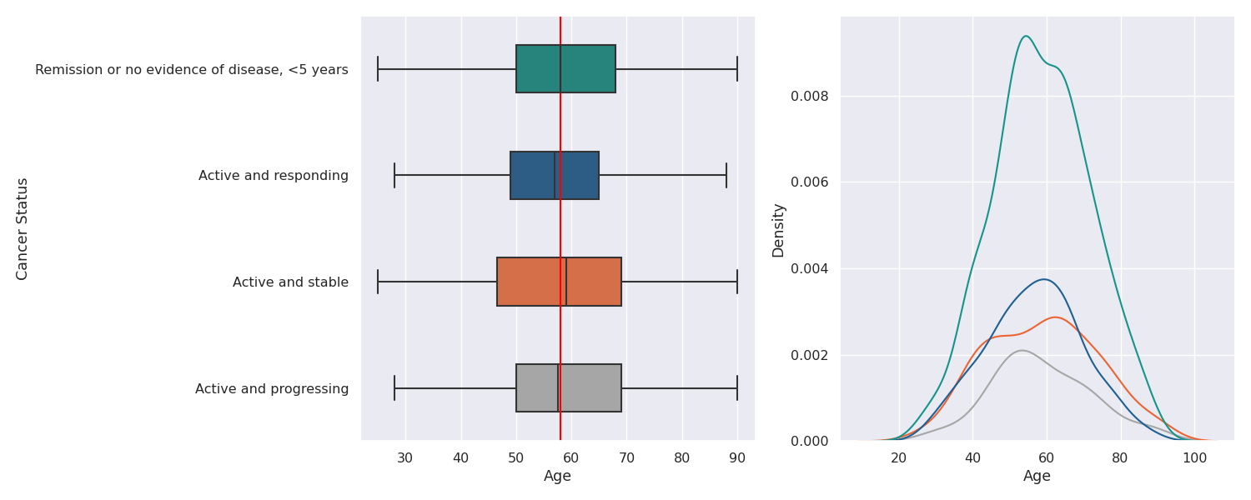
Age Distribution by Cancer Status
On average, women were 58 years of age independent of cancer status.

Slide 9
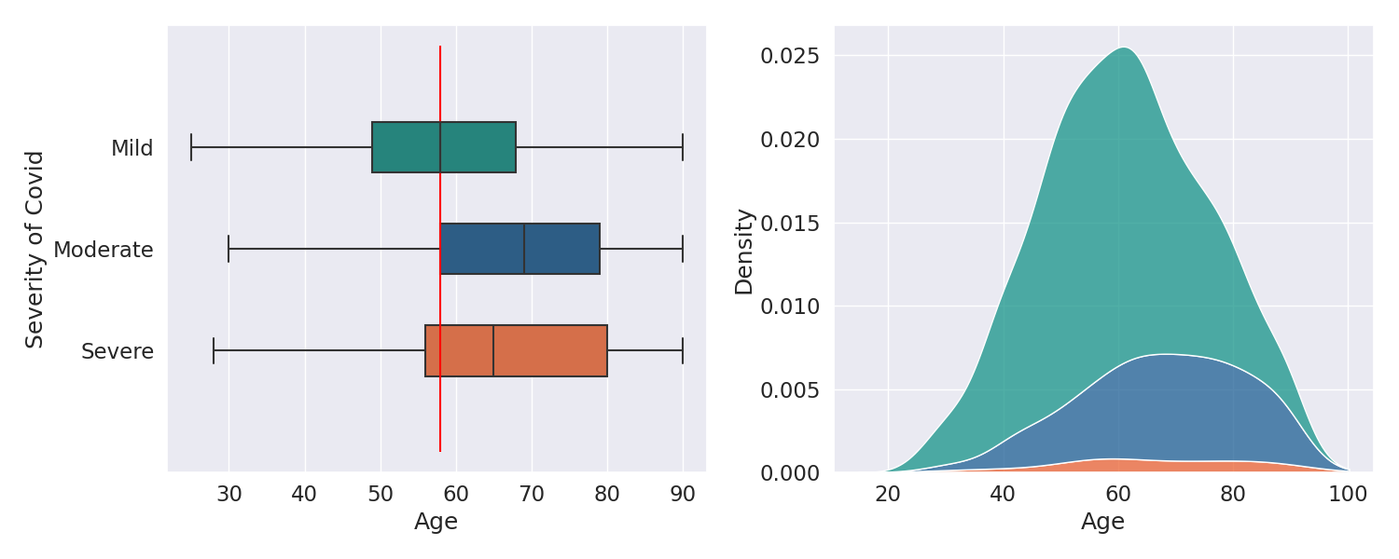
Age Distribution by COVID Status
Patients hospitalized (Moderate) or admitted to the ICU (Severe) for COVID are on average 64 and 60 years old, respectively.

Slide 10
INFLUENCE OF SMOKING ON THE SEVERITY OF COVID-19 IN INDIVIDUALS WITH BREAST CANCER.

Slide 11
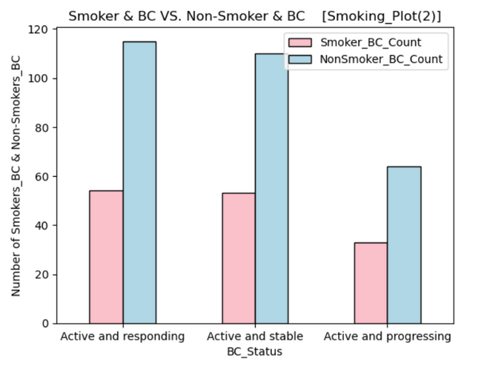
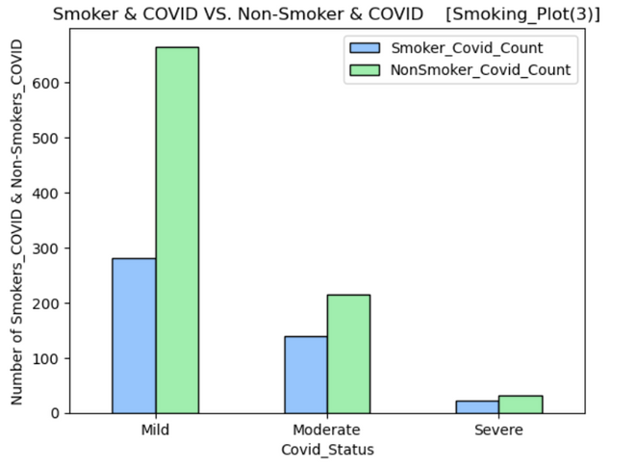
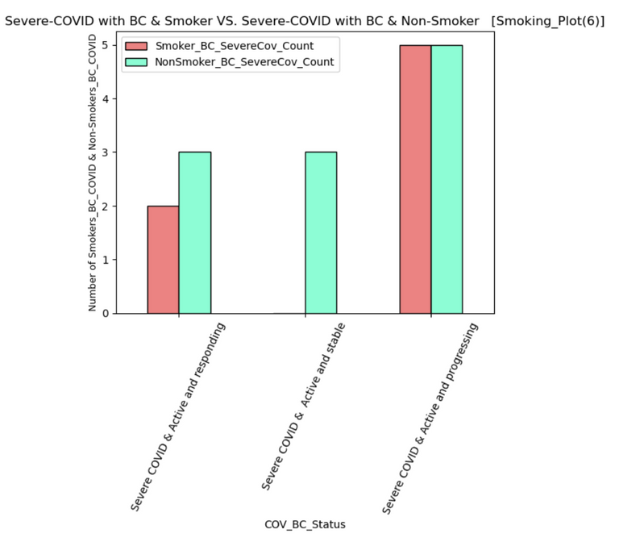
Hypothesis
Individuals who smoke and have Breast Cancer have a higher chance of having a severe COVID compared to the individuals who do not smoke.
Chi-Squared Test Result
P-value : 0.30
Since the p-value is greater than 0.05, we cannot reject the null hypothesis. This means that there is no significant
difference between the two data sets. Therefore, individuals who smoke and have Breast Cancer do not have a higher chance of having a severe COVID compared to the individuals who do not smoke.

Slide 12
THE RELATIONSHIP BETWEEN SMOKING, BREAST CANCER (BC) STATUS, AND COVID INCIDENCE ACROSS DIFFERENT RACIAL GROUPS

Slide 13
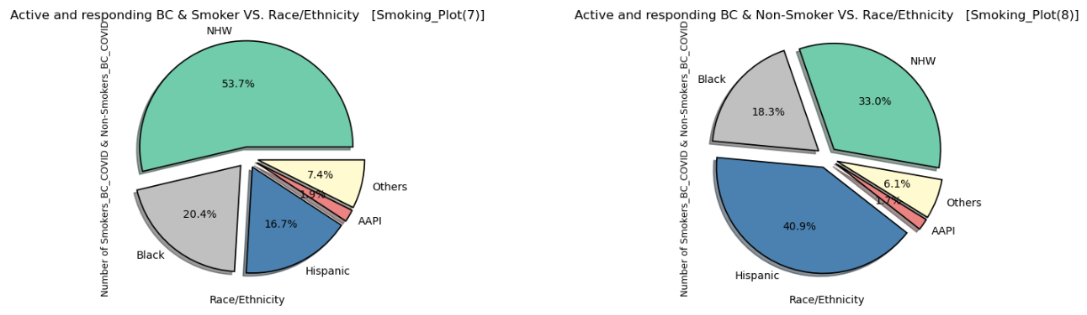
Active and responding BC
Hypothesis
Amongst all the races with different breast cancer statuses, smoking is a factor for them to have COVID.
Chi-Squared Test Result
P-value : 0.03
Since the p-value is smaller than 0.05, we reject the null hypothesis. This means that there is a significant difference between the two data sets. Therefore, amongst all the races with active and responding breast cancer statuses, smoking is a factor for them to have COVID.

Slide 14
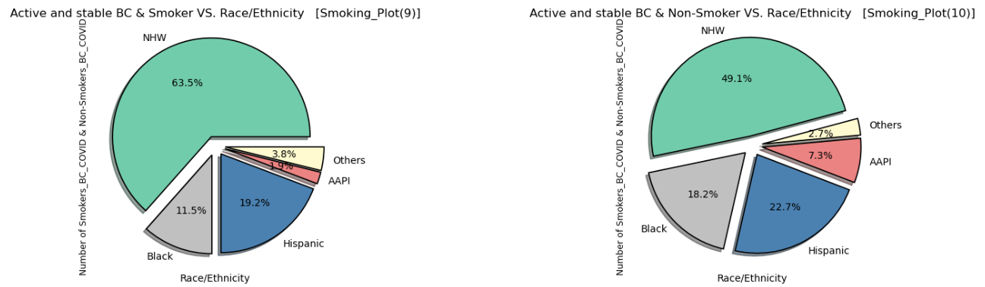
Active and stable BC
Hypothesis
Amongst all the races with different breast cancer statuses, smoking is a factor for them to have COVID.
Chi-Squared Test Result
P-value : 0.34
Since the p-value is greater than 0.05, we cannot reject the null hypothesis. This means that there is no significant difference between the two data sets. Therefore, amongst all the races with active and stable breast cancer statuses, smoking is not a factor for them to have COVID.

Slide 15
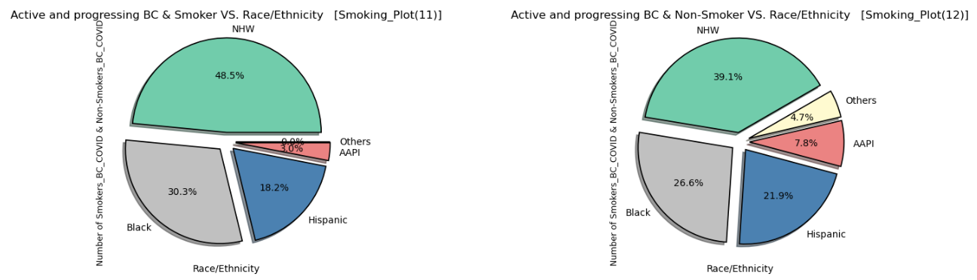
Active and progressing BC
Hypothesis
Amongst all the races with different breast cancer statuses, smoking is a factor for them to have COVID.
Chi-Squared Test Result
P-value : 0.55
Since the p-value is greater than 0.05, we cannot reject the null hypothesis. This means that there is no significant difference between the two data sets. Therefore, amongst all the races with active and progressing breast cancer statuses, smoking is not a factor for them to have COVID.

Slide 16
DOES OBESITY AND AGE HAVE AN AFFECT ON COVID WITH BREAST CANCER?

Slide 17
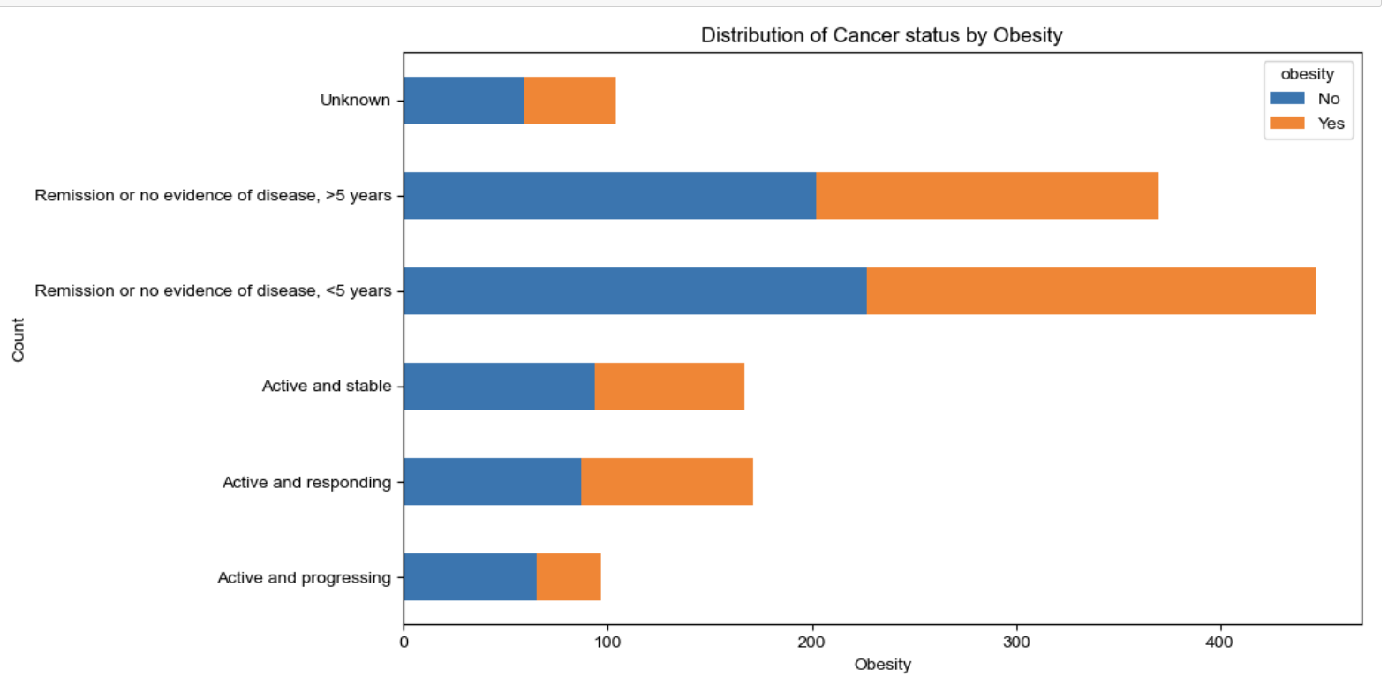
This chart shows the distribution of cancer status by obesity. This led to the discovery that the P-value which is equal to 0.07944 is above the significance level 0.05
In statistics, if the P-value is less than 0.05 we can reject the null hypothesis.
If the P-value is greater than 0.05 we fail to reject the hypothesis
Due to the outcome, there is now strong evidence to conclude that there is a correlation between obesity and cancer status. We fail to REJECT.

Slide 18
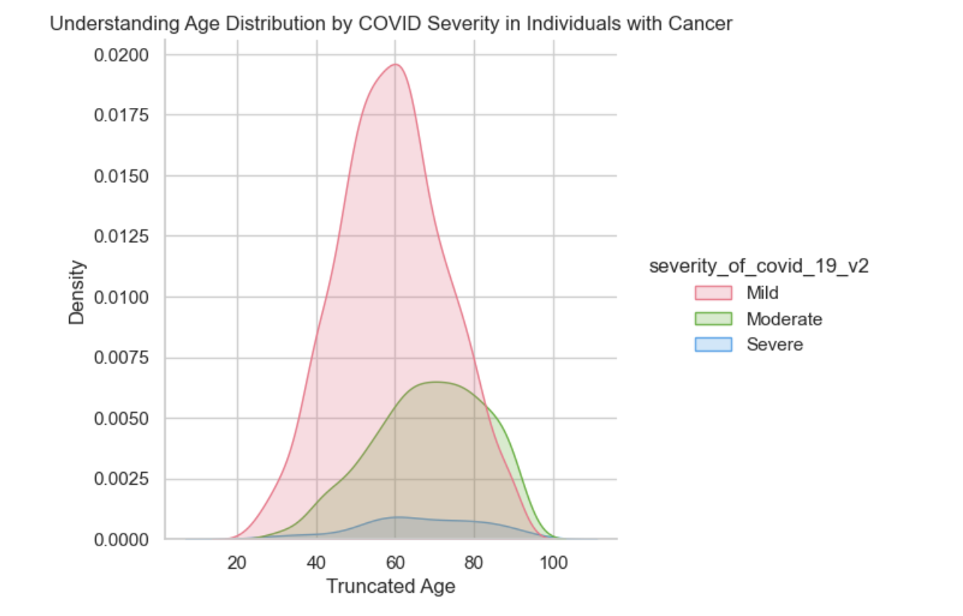
Understanding Age Distribution by COVID Severity in Individuals with Cancer using a KDE plot which helps us to visually assess how the age distribution density changes
based on different levels of COVID-19 severity. The Peaks and variations in the curve provide insights into whether certain age groups are more prone to severe COVID-19 outcomes among individuals with breast cancer, which suggests that as age increases, the likelihood of experiencing more severe symptoms also tends to rise.

Slide 19
THE INTERSECTION OF RACE/ETHNICITY, COVID-19, AND BREAST CANCER

Slide 20
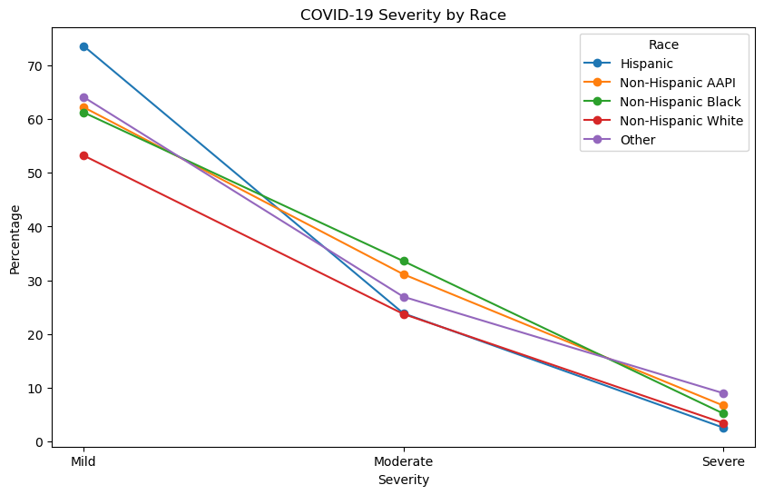
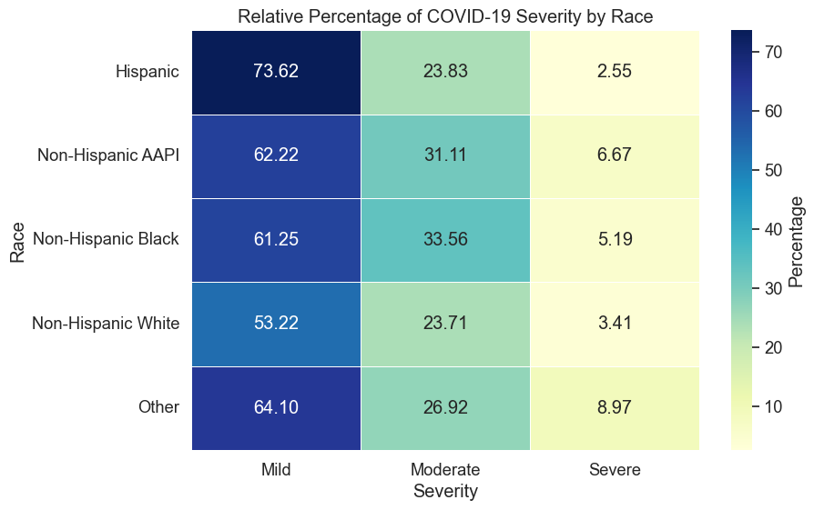
Hypothesis
There is a positive correlation between race and the incidence and severity of COVID-19, indicating that different racial groups may experience varying degrees of COVID-19 severity
Chi-Squared Test Result
P-value : 0.04
Since the p-value is smaller than 0.05, we reject the null hypothesis. Which indicate that different racial groups experience varying degrees of COVID-19 severity, with some groups being more adversely affected than others.

Slide 21
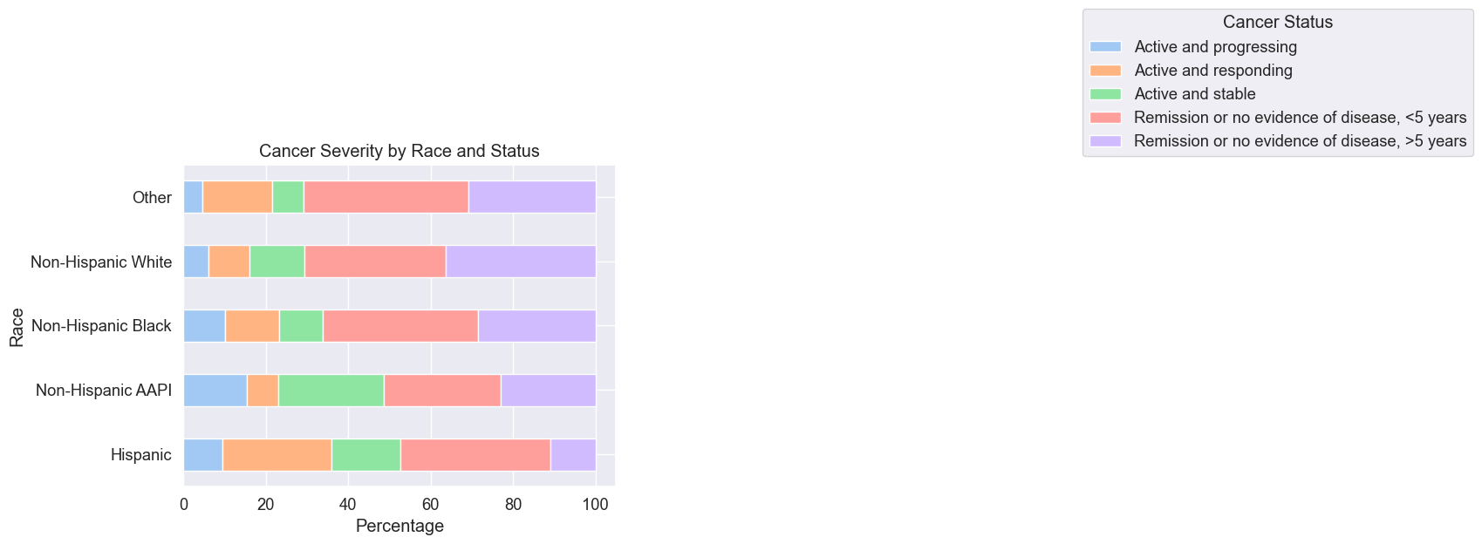
Hypothesis
The hypothesis suggests a positive association between race and the prevalence and severity of breast cancer, indicating that specific racial groups may exhibit differing rates of early-stage outcomes and active cancer cases.
Chi-Squared Test Result
-12
P-value : 2.81e
Since the p-value is smaller than 0.05, we reject the null hypothesis. Which indicate that there is a strong and statistically significant association between race and the prevalence and severity of breast cancer

Slide 22
IS THE SEVERITY OF COVID-19 AFFECTED IF THE INDIVIDUALS LIVE IN URBAN, SUBURBAN, OR RURAL AREAS?

Slide 23
Hypothesis
Null Hypothesis: There is no association between the severity of covid-19 and the type of residence
Alternate Hypothesis: There is an association between the severity of covid-19 and the type of residence

Slide 24
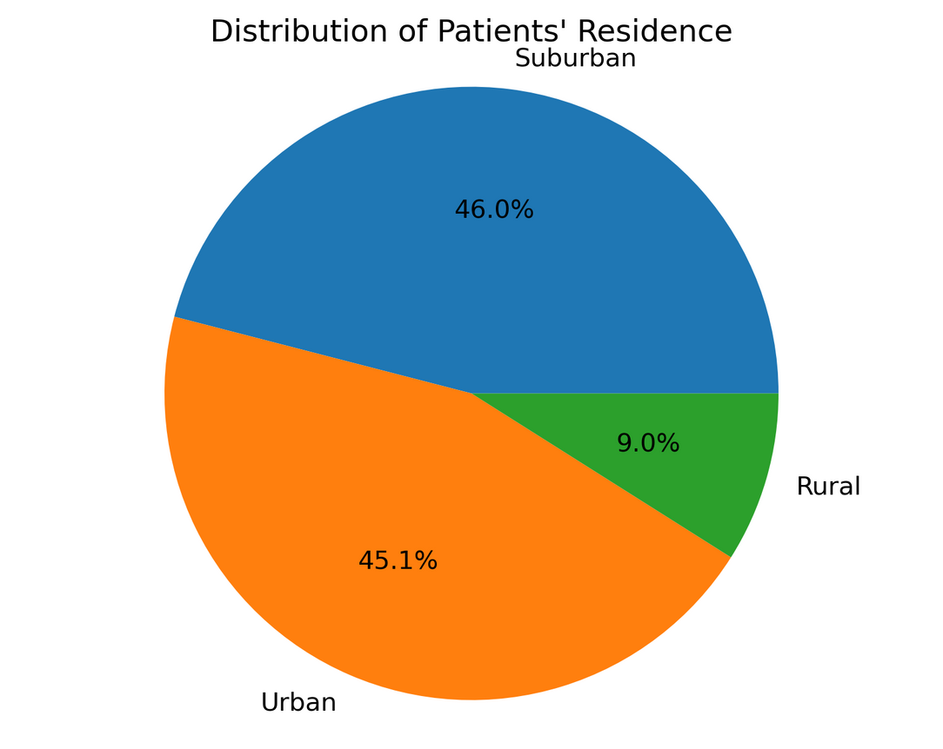
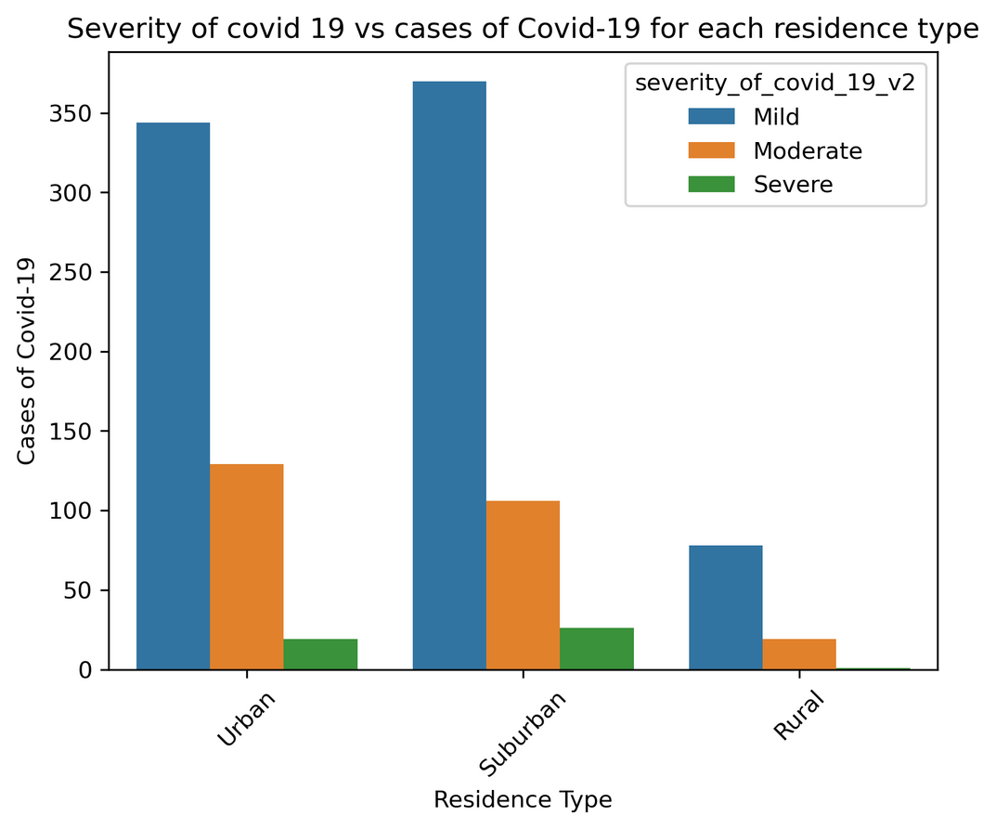

Slide 25
BREAST CANCER THERAPY AND ITS EFFECT ON COVID-19 SEVERITY

Slide 26
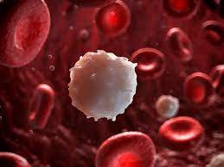
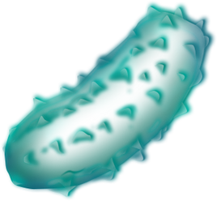
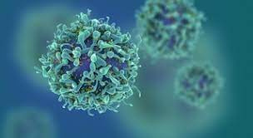
Reducing the number of white blood cells available to fight infection
Anti-Cancer Therapy (ACT) Compromises Immune System
Changing the way immune system responds to infection

Slide 27
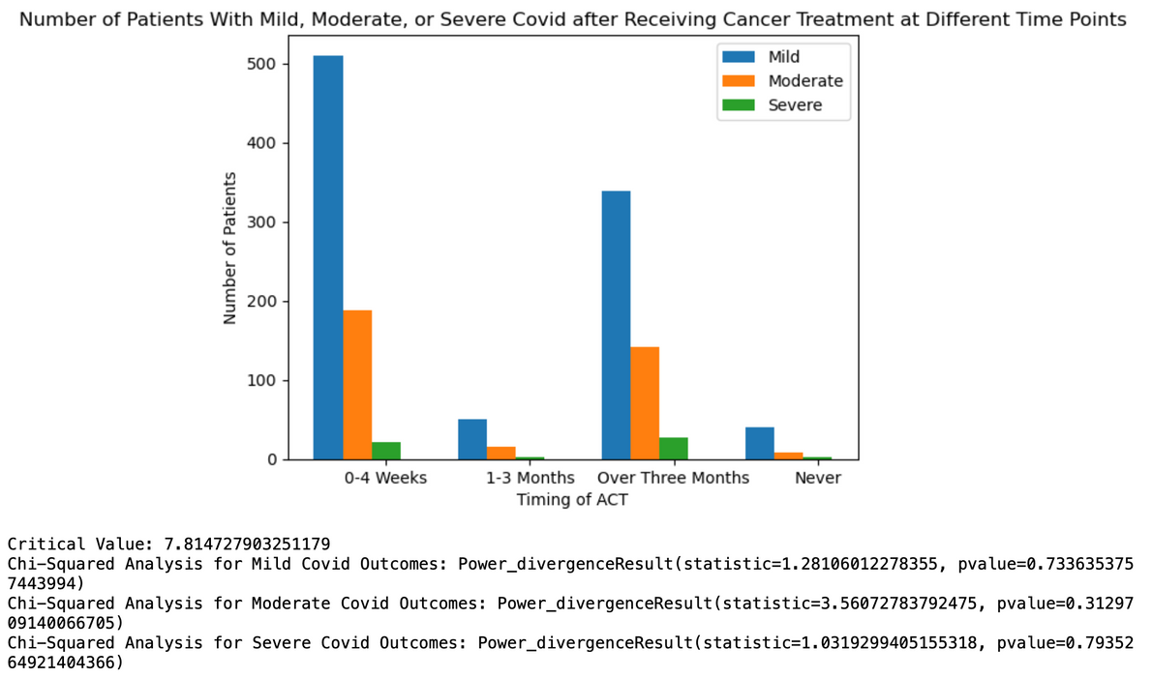
ACT Timing
Null Hypothesis
The timing of ACT has no effect on patient’s COVID-19 outcome
Alternative Hypothesis
ACT given closer to COVID-19 infection will cause greater moderate or severe COVID-19 outcomes than individuals who didn’t receive ACT
Data Collection
Calculate proportion of individuals who received ACT at different time points with mild, moderate, or severe COVID-19 outcomes
Results
p-value is less than 0.05
Fail to reject null hypothesis

Slide 28
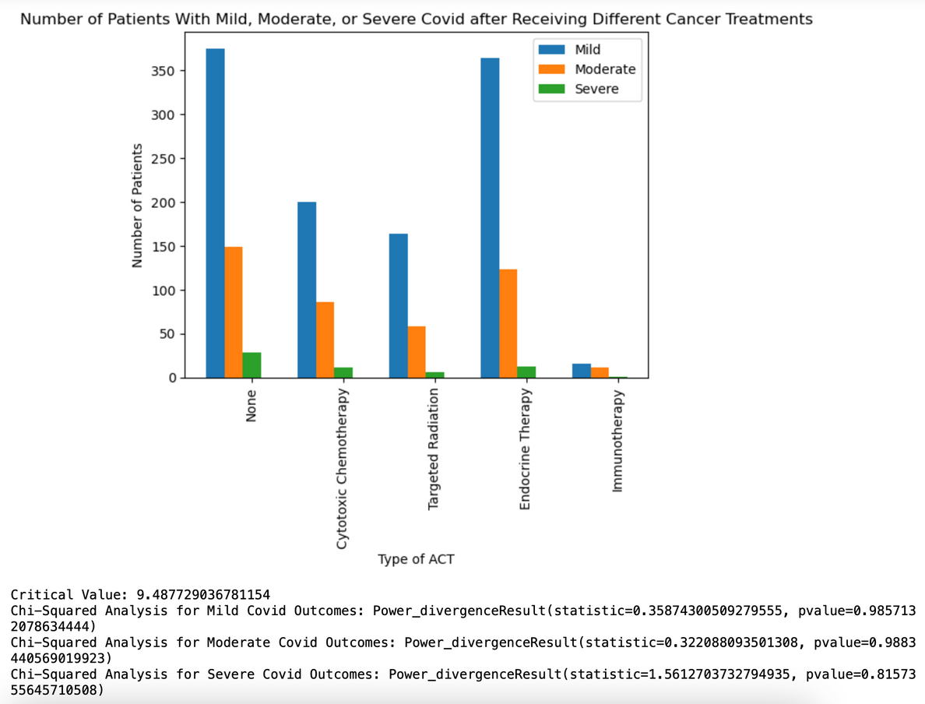
Type of ACT
Null Hypothesis
The type of ACT has no effect on patient’s COVID-19 outcome
Alternative Hypothesis
Different types of ACT will cause greater moderate or severe COVID-19 outcomes than individuals who didn’t receive ACT
Data Collection
Calculate proportion of individuals who received different ACT types with mild, moderate, or severe COVID-19 outcomes
Results
p-value is less than 0.05
Fail to reject null hypothesis

Slide 29
API

Slide 30
Information about Breast Cancer - API
Overview of Breast Cancer
Basics of Breast Cancer
Next Steps
Cost And Insurance

Slide 31

THANK YOU

